Slide 1
Compare between NoSQL/SQL

Slide 2
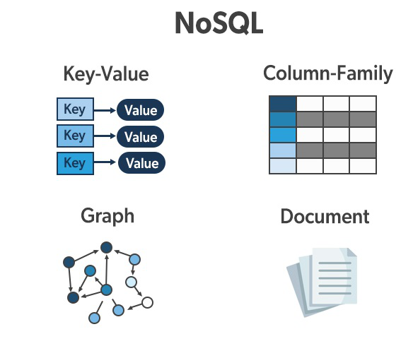
NoSQL
A NoSQL database provides a mechanism for storage and retrieval of data that is modeled in means other than the tabular relations used in relational databases. Such databases have existed since the late 1960s, but the name "NoSQL" was only coined in the early 21st century, triggered by the needs of Web 2.0 companies.

Slide 3

SQL
SQL is a domain-specific language used in programming and designed for managing data held in a relational database management system, or for stream processing in a relational data stream management system.

Slide 4
SQL vs MySQL
SQL is a query programming language that manages RDBMS. MySQL is a relational database management system that uses SQL. SQL is primarily used to query and operate database systems. MySQL allows you to handle, store, modify and delete data and store data in an organized way

Slide 5
What are MongoDB and MySQL?
MongoDB
MySQL
MongoDB is an open-source database developed by MongoDB, Inc. MongoDB stores data in JSON-like documents that can vary in structure. It is a popular NoSQL database.
MySQL is a popular open-source relational database management system (RDBMS) that is developed, distributed and supported by Oracle Corporation.

Slide 6
How Data is Stored?
MongoDB
MySQL
In MongoDB, each individual records are stored as ‘documents’.
In MySQL, each individual records are stored as ‘rows’ in a table.

Slide 7
SQL or NoSQL
MongoDB
MySQL
MongoDB is what is called a NoSQL database. This means that pre-defined structure for the incoming data can be defined and adhered to but also, if required different documents in a collection can have different structures. It has a dynamic schema.
MySQL as the name suggests uses Structured Query Language (SQL) for database access. The schema can not be changed. The inputs following the given schema are only entered.

